Slide 1



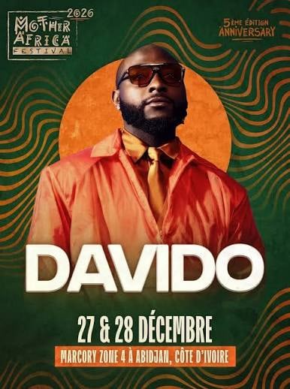
Maximising Mother Africa visibility
atoureconsulting.com
×
A proposal for the 5th edition of Mother Africa Festival: talent access, creator management on the ground and one visibility report.
27 and 28 December 2026, Marcory Zone 4, Abidjan.
Prepared by Baba Touré, Director · 30.10.2026
Notes:
Thank the Mother Africa team for the time. This proposal is about one thing: making the visibility that creators bring to the festival provable, so the festival can show it to sponsors. Everything on the next slide comes from the festival’s own posters and press material, so ask the team to correct anything we have wrong.

Slide 2



Four editions in, this is already working
×
WHERE WE STAND
15,000+
40%
WHAT THE 5TH EDITION NEEDS
Festival goers at the first edition, December 2022
Of them came from other countries, as reported
Creators chosen for the audiences the festival wants most
20,000+
1B+ FCFA
Set deliverables and key messages for every creator
Expected at the 5th edition, according to the organisers
Over 1 billion FCFA: the festival as a sponsorship instrument
A clear view of what each creator posts, and when
THE STORY SO FAR
Sponsor visibility the festival can prove, partner by partner
2022
2023
2024
2025
2026
First edition, 28 to 30 December in Abidjan
2nd edition: Aya Nakamura, Ayra Starr
3rd edition: Dadju and Tayc
4th edition: Gims, Asake. On France 24
5th edition: Davido headlines
Festival numbers: views, audiences, the diaspora, tickets
Sources: Africa Radio, Music In Africa, Abidjan.net, Liferadio, France 24, Pulse, allAfrica. 20,000+ is the organisers’ expected figure.
Notes:
Everything on the left comes from public reporting and the festival’s own announcements, so ask the team to correct anything we have wrong. 15,000 and 40 percent are the figures reported for the first edition in December 2022. 20,000 is what the organisers expect for the 5th edition, not a result. The 1 billion FCFA figure is the festival’s weight as a sponsorship instrument. The right side is what any festival needs once it sells its audience to sponsors: present it as the next stage, not as a list of faults. Sources: Africa Radio, Music In Africa, Abidjan.net, Liferadio, France 24, Pulse and allAfrica.

Slide 3
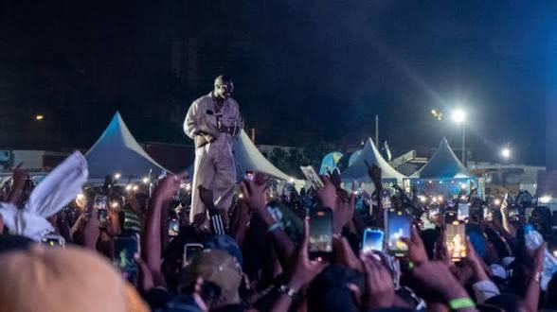
Set the foundation in the anniversary year
×
WHY NOW
Five editions in, with Davido headlining, sponsors will ask what the Mother Africa audience is worth. Every number the festival produces now builds that case.
5th
2 nights
Davido
ANNIVERSARY EDITION
27 AND 28 DECEMBER, MARCORY ZONE 4
HEADLINER, FOLLOWED ACROSS AFRICA AND THE DIASPORA
Your audience is already filming
THE REVENUE MODEL
WHERE THE NEW MONEY COMES FROM
MORE CREATORS
→
MORE VISIBILITY
→
BRAND KPIS MET
→
SPONSOR AND INVESTOR MONEY
Every phone in the crowd is a camera. AToure makes sure the right creators are holding them, and counts what they deliver.
AToure Management & Consulting
Notes:
An anniversary edition with a headliner of Davido’s size is when sponsors pay the most attention, so it is the year to start measuring. Look at any picture from the festival: phones up everywhere. That content already exists, but nobody directs it and nobody counts it. The revenue model is the chain at the bottom: more creators bring more visibility, visibility meets the brands’ goals, and met goals bring sponsor and investor money back for 2027. AToure supplies the creators and the proof at every link.

Slide 4




Mother Africa gives access. AToure does the rest
×
THE ATOURE ANSWER
WHAT MOTHER AFRICA PROVIDES
WHAT ATOURE DELIVERS
Accreditation and access zones for the creators
1
Talent access
Creators matched to the audiences Mother Africa wants
Brand guidelines and the key messages
2
Creator management on the ground
Ticket links, and codes if the festival wants them
Briefs, accreditation, approvals and one point of contact
3
The visibility report
One contact on the production team
A check at 48 hours, the full report on day 14
Creators produce visibility. AToure makes it provable, so the festival can sell it to sponsors.
Notes:
Two columns: what the festival provides, in orange, and what AToure delivers, in gold. The festival’s side is small on purpose: access for the creators, its brand guidelines and key messages, the ticket links, and one contact on production. Everything else is AToure’s: the creators, running them on the ground as the operator, and the report that makes the visibility provable.

Slide 5

AToure runs every creator, end to end
×
CREATOR MANAGEMENT ON THE GROUND
1
2
3
4
5
Scout and vet
Contract
Brief
Accredit
Check and post
Creators matched to the festival and checked for real audiences.
Deliverables, timing and usage rights agreed in writing.
Key messages, hashtags, the ticket link and sponsor mentions.
Passes, access zones and arrival times for both nights.
Drafts checked against the brief, then posted to the calendar.
and more…
and more…
and more…
and more…
and more…
AFTER THE FESTIVAL
One point of contact for the festival team
Every creator checked against the brief within 48 hours
Analytics collected by screen recording, not screenshots
A shared tracker of every creator and every post
and more…
Brand safety rules agreed with you before anyone posts
Notes:
This is the part the festival team never has to touch. AToure scouts and vets, agrees deliverables in writing, briefs, gets every creator accredited for both nights, and checks drafts before they go live. After the festival, every creator is checked against the brief within 48 hours, and analytics are collected by screen recording. One contact at AToure, and a shared tracker the team can look at any time.

Slide 6
Visibility builds in three waves
×
VISIBILITY
23 NOV TO 26 DEC
27 AND 28 DEC
29 DEC TO 10 JAN
Build up
Festival nights
Afterglow
Goal: awareness and ticket sales
Goal: live attention
Goal: keep the story alive
Creator lineup announced
Davido countdown
Weekly ticket pushes with tracked links
A last call before Christmas
Arrivals and festival looks
Crowd POV during headline sets
Sponsor activations in shot
A recap each night
Recap reels and best of edits
Creator thank you posts
Results shared with fans and partners
A 2027 save the date, if planned
Every wave sits in one content calendar, approved by the festival before anything goes live.
AToure Management & Consulting
Notes:
Visibility comes in three waves. The build up runs about five weeks and has one job: sell tickets. The two festival nights are about live reach, making people who are not there wish they were. The afterglow keeps Mother Africa in feeds into January and gives sponsors content to point to. If the festival plans a 2027 announcement, the afterglow is where it lands.

Slide 7
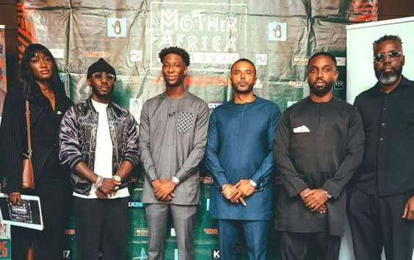




Every sponsor gets visibility it can prove
×
VISIBILITY
Written into every brief
Branding in shot
Sponsor mentions agreed in advance, so partners appear naturally.
Creators guided to every activation and stage banner on both nights.
A page per sponsor
Reusable content
Posts, views, screen time and a media value, clearly labelled as estimated.
The festival and its sponsors can share the best pieces again.
Mother Africa Festival press event
THE REVENUE MODEL
WHERE THE NEW MONEY COMES FROM
MORE CREATORS
→
MORE VISIBILITY
→
BRAND KPIS MET
→
SPONSOR AND INVESTOR MONEY
Notes:
Sponsors are paying for visibility, and creators are one of the best ways to deliver it. Sponsor mentions go into every brief, creators are guided to each activation and stage banner on both nights, and every partner gets its own page in the report. The revenue model is the same chain as before, seen from the sponsor’s side: more creators bring more visibility, visibility meets the brands’ goals, and met goals bring sponsor money back for 2027. Any media value is an estimate and is labelled as one.

Slide 8


Mother Africa gets the numbers on fixed dates
×
THE VISIBILITY REPORT
Weekly pulse
VISIBILITY REPORT · PAGE 1
EVERY MONDAY IN THE BUILD UP
Mother Africa Festival 2026
One page: posts live, views, top creators, ticket links used and what changes next.
3,200,000
1,450,000
48 hour check
Total views
Accounts reached
BY 30 DECEMBER 2026
Who posted, where, and against which brief. Anything missing is chased.
64
18
Posts checked against the brief
Creators
Full report
DAY 14, BY 11 JANUARY 2027
VIEWS BY PLATFORM
Every post and figure, audiences, tickets and sponsor pages, as a PDF with a web version.
Instagram
52%
TikTok
38%
YouTube
10%
See page 2: the detailed breakdown →
Sample layout. Figures are illustrative.
Page 2 →
Notes:
Three fixed dates. A one page weekly pulse during the build up, so effort moves to the creators who are working. A check 48 hours after the festival: who posted, where, against which brief. The full report on day 14, by 11 January 2027, as a PDF for the board and sponsors with a web version. The page on the right is a sample layout: its figures are illustrative, to show the format, and are not a forecast for the festival.

Slide 9
A trial at the 5th edition. One full report
×
THE PROPOSAL
AToure manages the creator activation for the 5th edition and delivers a full visibility report on the festival, built to go to sponsors and partners.
THE ACTIVATION
Creators matched to the festival’s audiences, managed on the ground before, during and after 27 and 28 December.
×
THE REPORT
A check at 48 hours and the full report on day 14, built for the festival team and for every sponsor.
27 and 28 December 2026 · Marcory Zone 4
A trial, not a long term commitment. It is what earns the conversation about 2027.
Notes:
This is a trial, not a long term ask. One edition: AToure runs the creators and delivers one full report on a fixed date. The trial is what earns the conversation about 2027. There is no price on this slide on purpose: scope and fees are agreed once the festival says yes.

Slide 10
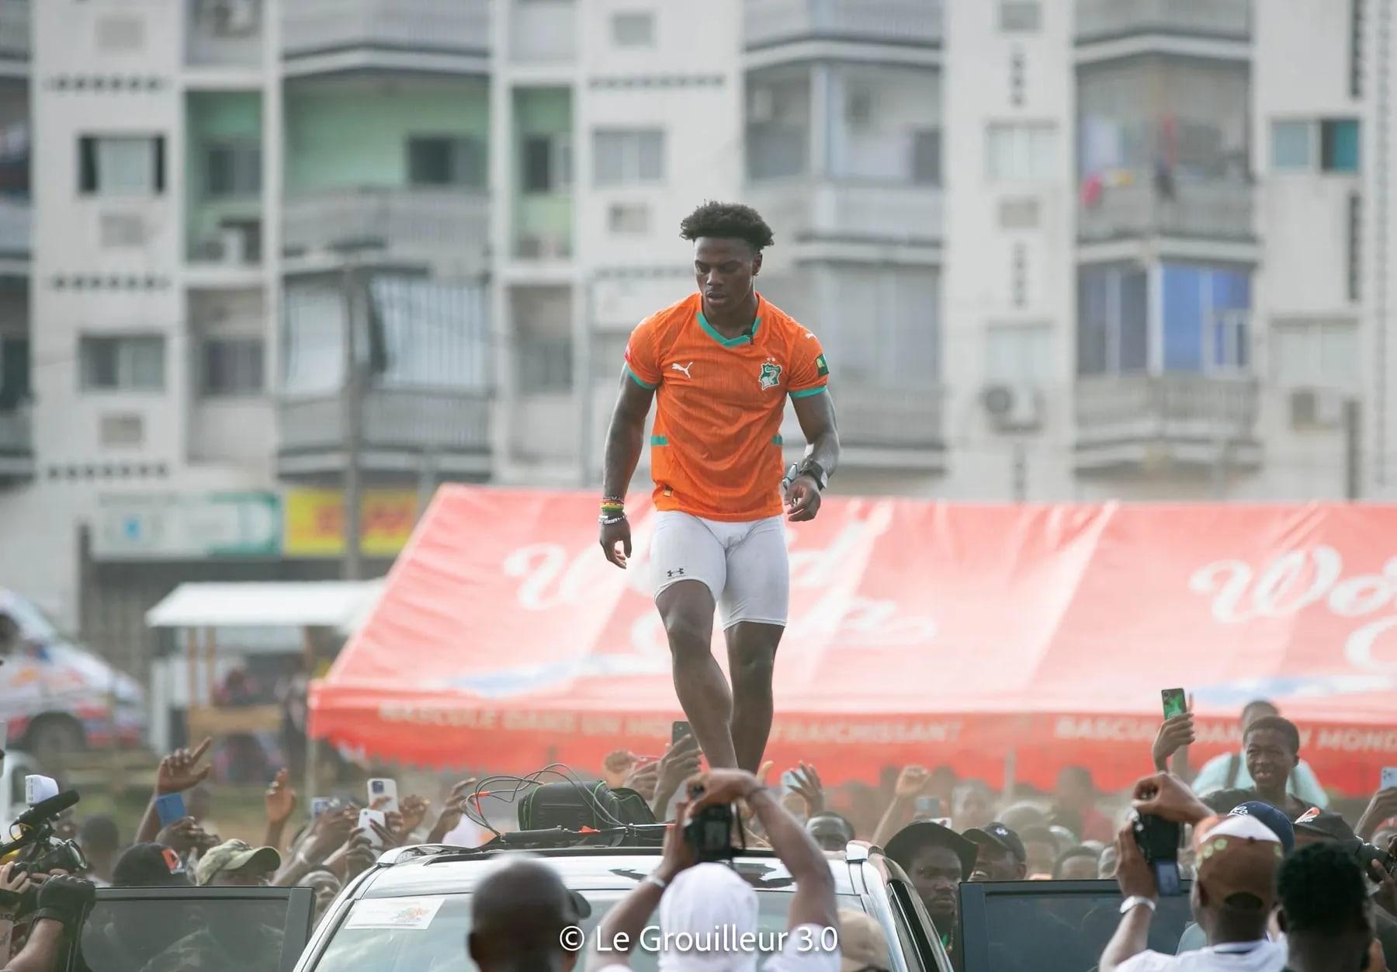
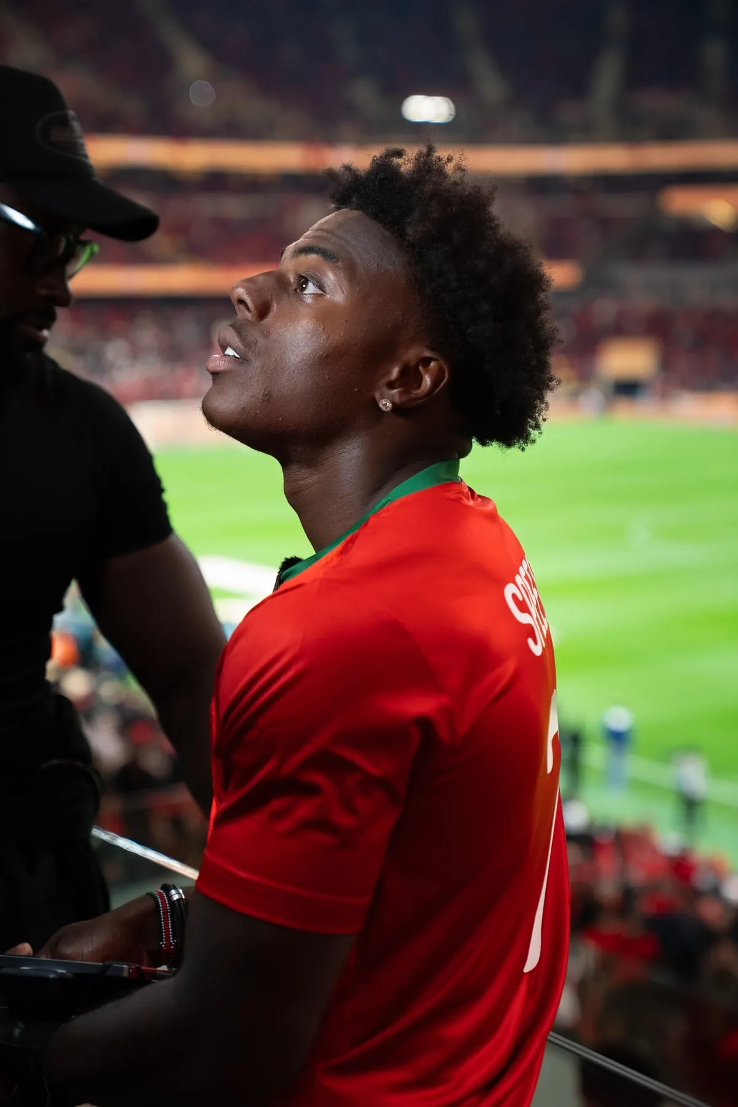
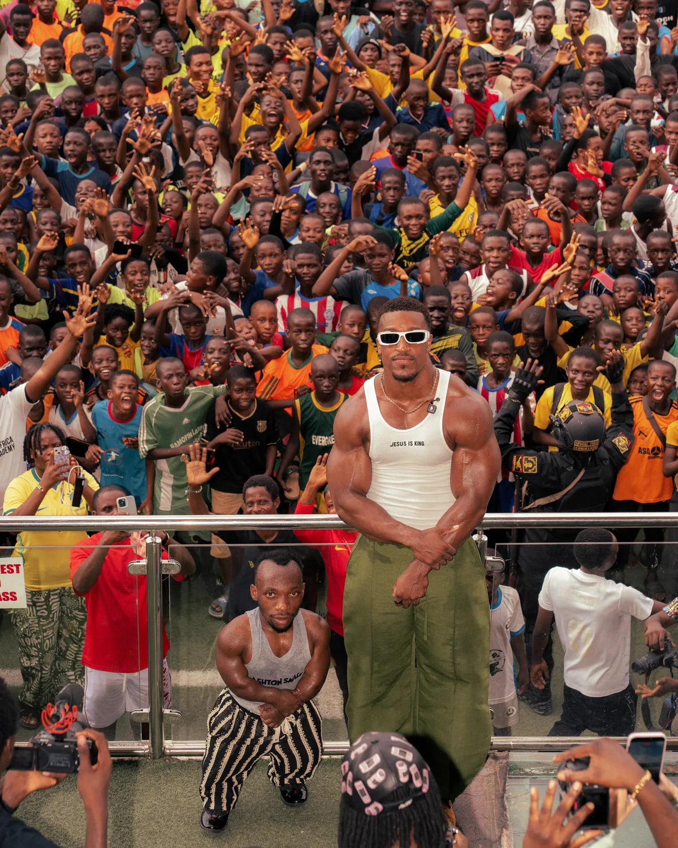
We have built and tracked this before
×
WHY ATOURE
Abidjan
Morocco, AFCON Final
Lagos
55.8M
16M
1.57B
Instagram views on one reel. IShowSpeed in Côte d’Ivoire.
Live stream views of the AFCON mascot reveal.
Tour views across five countries, managed end to end.
Sources: Instagram and YouTube analytics, tour figures supplied by the client.
AToure Management & Consulting
Notes:
This is not a new capability. In Abidjan, AToure built the IShowSpeed operation from zero. In Morocco it delivered the AFCON mascot reveal with CAF and the Royal Moroccan Football Federation. The Ashton Hall tour covered five countries, managed end to end.

Slide 11
Let us build the 5th edition together
THE ASK
1
Confirm the scope and agree the targets
This week
2
Approve the creator shortlist
By Friday 13 November
3
Creators signed and briefed
By Friday 20 November
4
Build up content goes live
From Monday 23 November
EMAIL
WHATSAPP
ONLINE
baba@atoureconsulting.com
+44 7456 728616
atoureconsulting.com · @atoure.management
Baba Touré, Director. AToure Management & Consulting.
Notes:
Close here. To be ready for 27 December, the work starts on Monday 2 November. Four steps: confirm the scope and targets this week, approve the shortlist by 13 November, creators signed and briefed by 20 November, build up content live from 23 November. Do not read past this slide: let the ask land, and let the Mother Africa team respond.

Slide 12
Every number breaks down, creator by creator
×
APPENDIX · SAMPLE REPORT, PAGE 2
VISIBILITY REPORT · PAGE 2
Mother Africa Festival 2026
BY CREATOR
AUDIENCE
Creator | Posts | Views | Interactions | Ticket clicks
Creator A | 6 | 820,000 | 61,000 | 2,100
Creator B | 5 | 610,000 | 48,500 | 1,650
Creator C | 4 | 455,000 | 39,200 | 1,240
Creator D | 4 | 380,000 | 27,800 | 980
Creator E | 3 | 290,000 | 22,100 | 730
13 other creators | 42 | 645,000 | 51,400 | 2,700
Total | 64 | 3,200,000 | 250,000 | 9,400
Côte d’Ivoire
58%
Diaspora abroad
24%
Rest of Africa
18%
SPONSOR VALUE
Partner | Moments | Screen time | Media value, estimated
Partner A | 42 | 6 min 10 s | 18.5M FCFA
Partner B | 31 | 4 min 25 s | 12.7M FCFA
Partner C | 18 | 2 min 40 s | 7.3M FCFA
The full report also lists every post with its link, platform and time, and ends with recommendations. Every figure comes from creator analytics, tracked links or ticketing data; anything modelled is labelled estimated.
Sample layout. Figures are illustrative.
← Back to page 1
Notes:
Page 2 of the sample report, to show the depth behind the headline numbers: every creator with posts, views, interactions and ticket clicks, where the audience was, and what each partner received. The figures are illustrative and add up to page 1; they are not a forecast. The full report also lists every post with its link and time, and ends with recommendations for the next edition.

